Slide 1

Learning from multiple tasks
Multi-task learning
deeplearning.ai

Slide 2
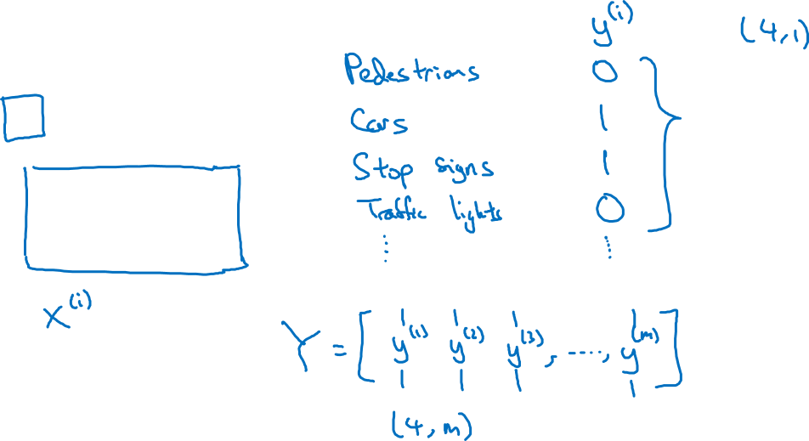
Simplified autonomous driving example

Slide 3

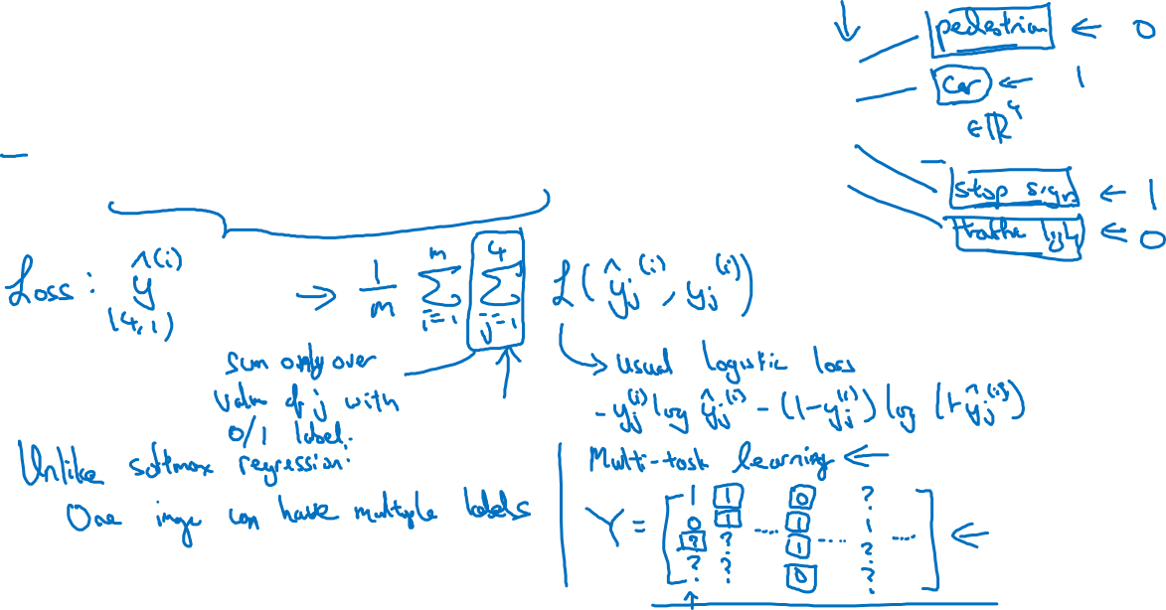
Neural network architecture
x
$$\hat{y}$$

Slide 4
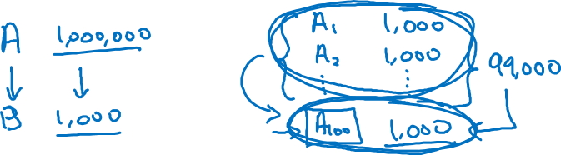
When multi-task learning makes sense
Training on a set of tasks that could benefit from having shared lower-level features.
Usually: Amount of data you have for each task is quite similar.
Can train a big enough neural network to do well on all the tasks.

